Slide 1
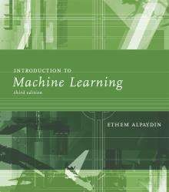
Lecture Slides for
INTRODUCTION TO
MACHİNE LEARNİNG
3RD EDİTİON
ETHEM ALPAYDIN
© The MIT Press, 2014
alpaydin@boun.edu.tr
http://www.cmpe.boun.edu.tr/~ethem/i2ml3e

Slide 2
CHAPTER 7:
CLUSTERİNG

Slide 3
Semiparametric Density Estimation
3
Parametric: Assume a single model for p (x | C_{i}) (Chapters 4 and 5)
Semiparametric: p (x|C_{i}) is a mixture of densities Multiple possible explanations/prototypes: Different handwriting styles, accents in speech
Nonparametric: No model; data speaks for itself (Chapter 8)

Slide 4
Mixture Densities
4
k
p(x) = ∑p(x|G_{i} )P(G_{i} )
where G_{i} the compo^{i =}n¹ents/groups/clusters, P ( G_{i} ) mixture proportions (priors), p ( x | G_{i}) component densities
Given a sample and k, learning corresponds to estimating the component densities and proportions.
When we assume that the component densities obey a parametric model, we need only estimate their parameters.

Slide 5

Contd..
5
If the component densities are multivariate Gaussian where p(x|G_{i}) ~ N ( μ_{i} , ∑_{i} )
Φ = {P ( G_{i} ), μ_{i} , ∑_{i} }^{k} unlabeled sample X={x^{t}}_{t}
i=1
(unsupervised learning).
In Parametric classification Gi, correspond to classes, Ci, component densities p(x|Gi) correspond to class densities p(x|Ci), and P (Gi) correspond to class priors, P (Ci) then

Slide 6
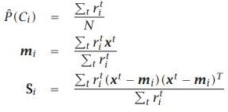
Contd…
6
When we are given the sample X={x^{t}, r^{t}}^{N} , where
t=1
r ^{t} _{i} = 1 if x^{t} ∈ Ci and 0 otherwise, the parameters can be calculated using maximum likelihood.
The parameters are estimated as

Slide 7
7
If the sample is X={x^{t}}_{t}: We have an unsupervised learning problem.
We are given only x^{t} and not the labels r^{t}, that is, we do not know which x^{t} comes from which component.
So we should estimate both: First, we should estimate the labels, r ^{t} _{i} , the component that a given instance belongs to; and, second, once we estimate the labels, we should estimate the parameters of the components given the set of instances belonging to them.

Slide 8
Classes vs. Clusters
8
Supervised: X = {x^{t},r^{t} }_{t}
Classes C_{i} i=1,...,K
Unsupervised : X = { x^{t} }_{t}
Clusters G_{i} i=1,...,k
K
p(x) = ∑p(x|C )P(C )
k
∑
i =1
p(x) =
p(x|G )P(G )
i i
i i
i =1
where p(x|C_{i}) ~ N(μ_{i} ,∑_{i} )
Φ = {P (C_{i} ), μ_{i} , ∑_{i} }^{K}_{i=1}
where p(x|G_{i}) ~ N ( μ_{i} , ∑_{i} )
Φ = {P ( G_{i} ), μ_{i} , ∑_{i} }^{k}
i=1
∑ ∑
r
t
t t
P^{ˆ}(C ) =
r x
t
i
m =
t
i
i
N
i
∑ i
t
r
t
∑
r ( − m )(
x − m )
T
Labels r^{t} ?
i
t t
t
x
S =
t
i
i
i
i
∑
r
t
t
i

Slide 9
Unsupervised Learning
9
Applications
Segmentation of target consumer populations by an advertisement consulting agency on the basis of few dimensions such as demography, financial data, purchasing habits, etc. so that the advertisers can reach their target consumers fficiently
Anomaly or fraud detection in the banking sector by identifying the patternof loan defaulters
Image processing and image segmentation such as face recognition, expression identification, etc.

Slide 10
Contd...
10
Grouping of important characteristics in genes to identify important influencers in new areas of genetics.
Utilization by data scientists to reduce the dimensionalities in sample data to simplify modelling.
Document clustering and identifying potential labelling options.

Slide 11
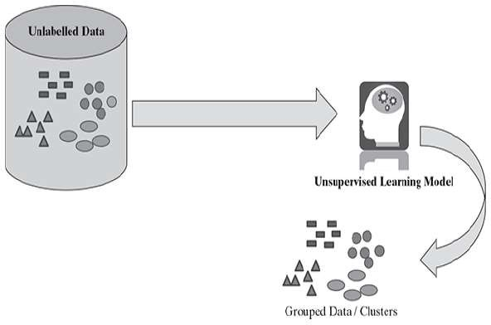
Learning Model
11

Slide 12
K-means Clustering
12
An image is stored with 24 bits/pixel and we have a color screen with 8 bits/pixel that can display only 256 colors.
We want to find the best 256 colors such that the image using only the 256 colors in the palette looks as close as possible to the original image.
color quantization: This is color quantization where we map from high to lower resolution.

Slide 13
13
In general , the aim is to map from a continuous space to a discrete space; this process is called vector quantization.
If we quantize uniformly then this wastes the colormap by assigning entries to colors not existing in the image, or would not assign extra entries to colors frequently used in the image.
So the distribution of the colormap entries should reflect the original density as close as possible

Slide 14

Contd…
14
We have a sample of X={x^{t}}^{N} _{t=1}.
We have k reference vectors, m_{j} , j = 1,...,k.
In our example of color quantization, x^{t} are the image pixel values in 24 bits and m_{j} are the color map entries also in 24 bits, with k = 256.
Then in displaying the image, given the pixel, x^{t}, we represent it with the most similar entry, mi in the color map, satisfying

Slide 15
Contd..
15
We use the closest value we have in the alphabet of reference vectors.
m_{i} are also called codebook code words vectors or code words, because this is a process of encoding/decoding.
Quantization also allows compression
We can just store/transfer its index i in the colormap using 8 bits to index any one of 256, and we get a compression rate of almost 3.

Slide 16
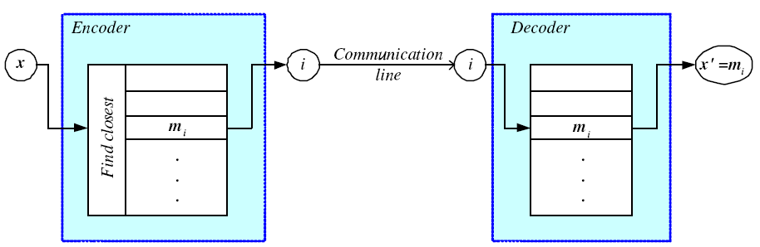
Encoding/Decoding
16
t
⎧⎪1
if x^{t} − m
= min x^{t} − m
j
b =
⎨
i
j
i
⎪⎩0 otherwise

Slide 17
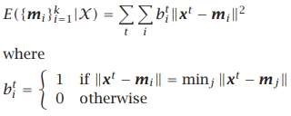
Contd…
17
we can calculate mi as follows:
For the new image to look like the original image, we should have these distances as reconstruction small as possible for all pixels.
The total reconstruction error is defined as

Slide 18
18
The best reference vectors are those that minimize the total reconstruction error.
We have an iterative procedure named k-means clustering for this:
First, we start with some mi initialized randomly. Then at each iteration calculate b^{t} _{i} for all x^{t}, which are the estimated labels.
if b^{t} _{i} is 1, we say that x^{t} belongs to the group of mi.

Slide 19

19
once we have these labels taking derivative with respect to mi and setting it to 0, we get
This is an iterative procedure because once we calculate the new mi, b^{t} _{i} change and need to be recalculated, which in turn affect mi.

Slide 20
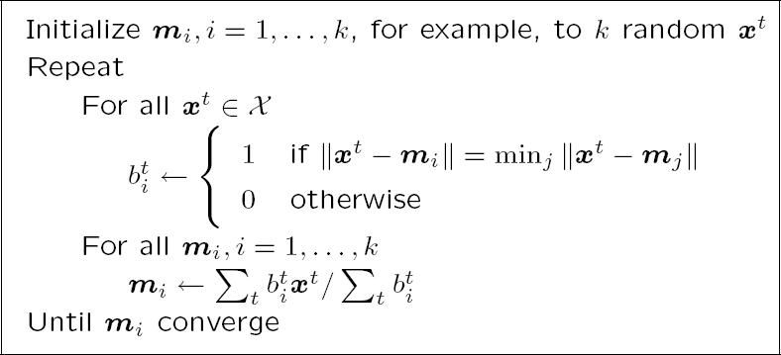
k-means Clustering
20

Slide 21
k-Means Clustering
21
Find k reference vectors (prototypes/codebook vectors/codewords) which best represent data
Reference vectors, m_{j}, j =1,...,k
Use nearest (most similar) reference:
_{x}t
m = min x^{t} − m
i
j
j
E({m } X )=
∑ ∑
t _{x}t
Reconstruction error
k
b
m
i
i =1
t
i
i i
_{b}t
⎧⎪1
if x^{t} − m
= min x^{t} − m
= ⎨
i
j
j
i
⎪⎩0 otherwise

Slide 22
22
There are various methods for initialization:
🞑 We can simply take randomly selected k instances as the initial mi.
🞑 The mean of all data can be calculated and small random vectors may be added to the mean to get the k initial mi.
🞑 We can calculate the principal component, divide its range into k equal intervals, partitioning the data into k groups, and then take the means of these groups as the initial centers.
After convergence, all the centers should cover some subset of the data instances and be useful;

Slide 23
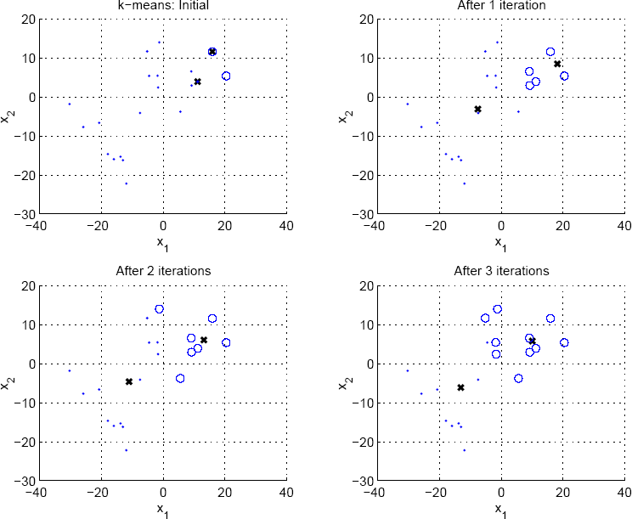
23

Slide 24
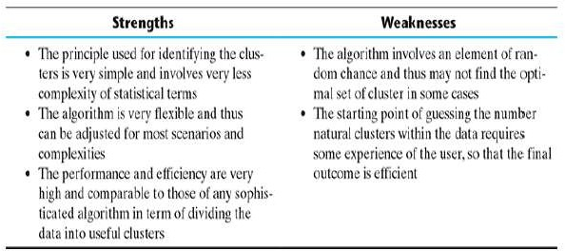
Contd…
24

Slide 25
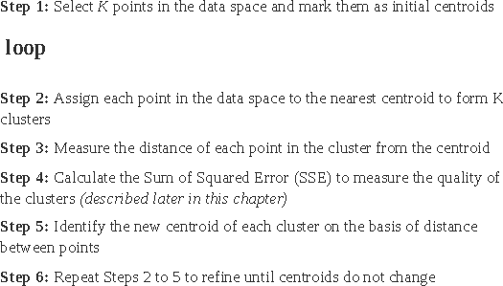
Contd…
25

Slide 26
Problem
26
Cluster the following eight points (with (x, y) representing locations) into three clusters:
A1(2, 10), A2(2, 5), A3(8, 4), A4(5, 8), A5(7, 5),
A6(6, 4), A7(1, 2), A8(4, 9)
Initial cluster centers are: A1(2, 10), A4(5, 8) and A7(1, 2).
Use the Ρ(a, b) = |x2 – x1| + |y2 – y1|

Slide 27
Contd…
27
Iteration 1
Ρ(A1, C1)
= |x2 – x1| + |y2 – y1|
= |2 – 2| + |10 – 10|
= 0
Ρ(A1, C2)
= |x2 – x1| + |y2 – y1|
= |5 – 2| + |8 – 10|
= 3 + 2
= 5

Slide 28
Contd..
28
Ρ(A1, C3)
= |x2 – x1| + |y2 – y1|
= |1 – 2| + |2 – 10|
= 1 + 8
= 9
Similarly we do for all the remaining points

Slide 29
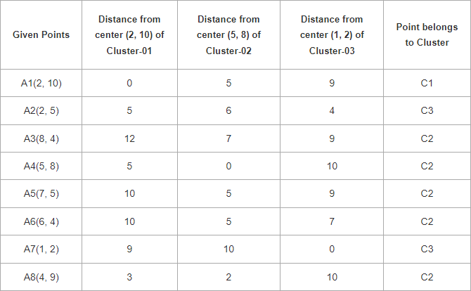
Contd..
29

Slide 30
Contd..
30
The new clusters are
Cluster-01:
First cluster contains points-
A1(2, 10)
Cluster-02:
Second cluster contains points-
A3(8, 4),A4(5, 8),A5(7, 5),A6(6, 4),A8(4, 9)
Cluster-03:
A2(2, 5), A7(1, 2)

Slide 31
Contd…
31
We re-compute the new cluster clusters.
The new cluster center is computed by taking mean of all the points contained in that cluster.
New Centroids are calculated as follows
For Cluster-01:
We have only one point A1(2, 10) in Cluster-01.
For Cluster-02:
Center of Cluster-02
= ((8 + 5 + 7 + 6 + 4)/5, (4 + 8 + 5 + 4 + 9)/5)
= (6, 6)

Slide 32
32
For Cluster-03:
Center of Cluster-03
= ((2 + 1)/2, (5 + 2)/2)
= (1.5, 3.5)

Slide 33
33
Iteration-02:
We calculate the distance of each point from each of the center of the three clusters.
The distance is calculated by using the given distance function.

Slide 34
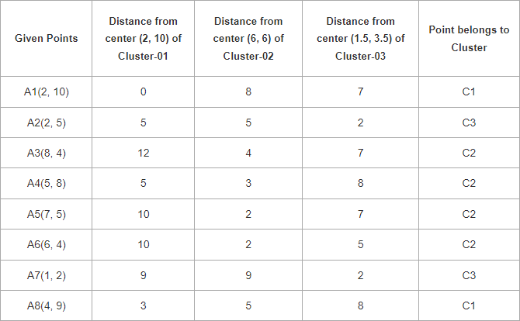
Contd..
34

Slide 35
Contd..
35
Cluster-01:
First cluster contains points-
A1(2, 10),A8(4, 9)
Cluster-02:
Second cluster contains points-
A3(8, 4),A4(5, 8),A5(7, 5),A6(6, 4)
Cluster-03:
Third cluster contains points-
A2(2, 5),A7(1, 2)

Slide 36
Contd..
36
For Cluster-01:
Center of Cluster-01
= ((2 + 4)/2, (10 + 9)/2)
= (3, 9.5)
For Cluster-02:
Center of Cluster-02
= ((8 + 5 + 7 + 6)/4, (4 + 8 + 5 + 4)/4)
= (6.5, 5.25)
For Cluster-03:
Center of Cluster-03
= ((2 + 1)/2, (5 + 2)/2)
= (1.5, 3.5)

Slide 37
37
There are also algorithms for adding new centers incrementally or deleting empty ones
In leader cluster algorithm, an instance that is far away from existing centers (defined by a threshold value) causes the creation of a new center at that point.
Or, a center that covers a large number of instances can be split into two.
A center that covers too few instances can be removed and restarted from some other part of the input space

Slide 38
Contd..
38
Vector quantization is one application of clustering, but clustering is also used for preprocessing before a later stage of classification or regression

Slide 39
Expectation-Maximization (EM)
39
Approach is probabilistic and we look for the component density parameters that maximize the likelihood of the sample.
Log likelihood with a mixture model
L(Φ|X ) = log∏p(x^{t} |Φ)
t
k
∑
p(x^{t} |G )P(G )
i i
= ∑ log
t
Assume hidden variable^{i}s⁼¹z, which when known, make optimization much simpler
Complete likelihood, L_{c}(Φ |X,Z), in terms of x and z
Incomplete likelihood, L(Φ |X), in terms of x

Slide 40
Contd..
Φ includes the priors P(Gi).
We cannot solve for the parameters analytically and need
to resort to iterative optimization.
The expectation-maximization algorithm is used in
maximum likelihood estimation where the problem
involves two sets of random variables of which one,X, is
observable and the other, Z, is hidden.
The goal of the algorithm is to find the parameter vector Φ that maximizes the likelihood of the observed values of X, L(Φ|X).
We associate the extra hidden variables Z and express the underlying model using both, to maximize the likelihood of the joint distribution of X and Z, the complete likelihood Lc(Φ|X,Z).

Slide 41
E- and M-steps
40
Iterate the two steps
E-step: Estimate z given X and current Φ
M-step: Find new Φ’ given z, X, and old Φ.
( ) [ ]
E - step : Q
l
L (Φ|X,Z )
l
Φ|Φ = E
|X,Φ
C
M- step : Φ^{l +1} = argmaxQ (Φ|Φ^{l} )
Φ
An increase in Q increases incomplete likelihood
L(Φ^{l +1} |X )≥ L(Φ^{l} |X )

Slide 42
In the case of mixtures, the hidden variables are the sources of observations.
If these were given, for example, as class labels in a supervised setting, we would know which parameters to adjust to fit that data point.
The EM algorithm works as follows: in the E-step we estimate these labels given our current knowledge of components, and in the M-step we update our component knowledge given the labels estimated in the E-step.

Slide 43
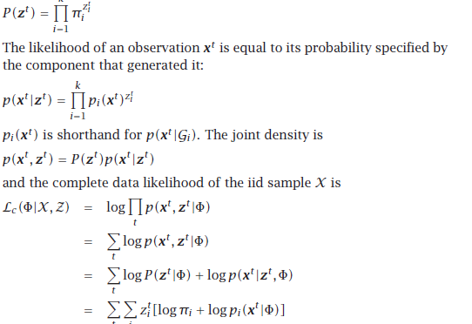

Slide 44
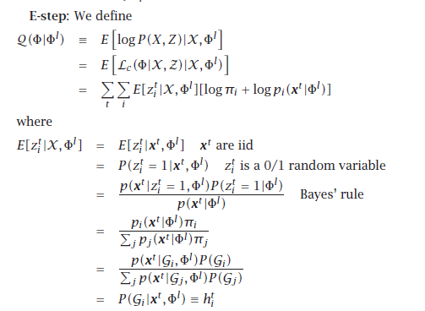

Slide 45
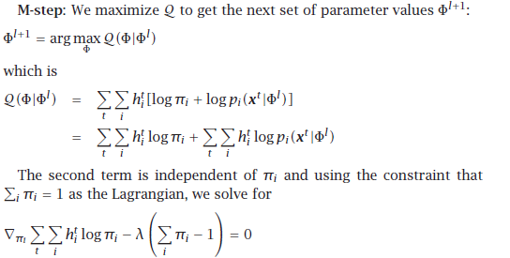


Slide 46
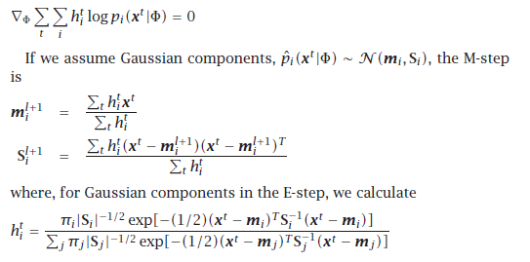

Slide 47
EM in Gaussian Mixtures
41
z^{t}_{i} = 1 if x^{t} belongs to G_{i}, 0 otherwise (labels r ^{t}_{i} of supervised learning); assume p(x|G_{i})~N(μ_{i},∑_{i})
p(x^{t} |G , Φ^{l} )P(G )
i i
E[z_{i} ]
t
l
X ,Φ =
p(x |G , Φ )
P(G )
E-step:
∑
t l
j
j
j
= P(G |x , Φ )≡ h
t
t l
t
i i
M-step:
∑
h
∑
t t
_{m}l +1 ₌
h x
P(G ) =
t
i
t
i
i
N
i
∑
h
t
Use estimated labels in place of unknown labels
t
i
∑
h ( − m )(
x − m )
T
t t
l +1 t
l +1
_{S}l +1 ₌
x
t
i
i
i
i
∑ i
h
t
t

Slide 48
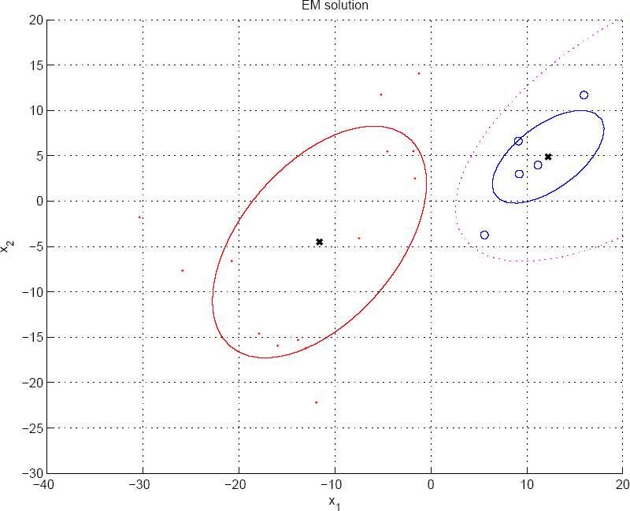
P(G₁|x)=h₁=0.5
42

Slide 49
EM is initalized by k-means. After a few iterations of k-means, we get the estimates for the centers mi , and using the instances covered by each center, we estimate the Si and give us the πi .
We run EM from that point on.

Slide 50
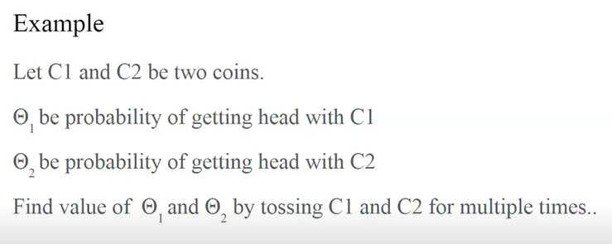
Example

Slide 51
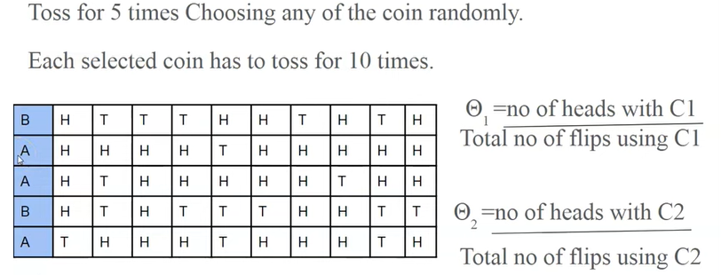

Slide 52
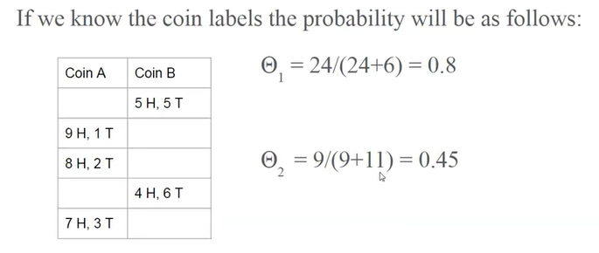

Slide 53
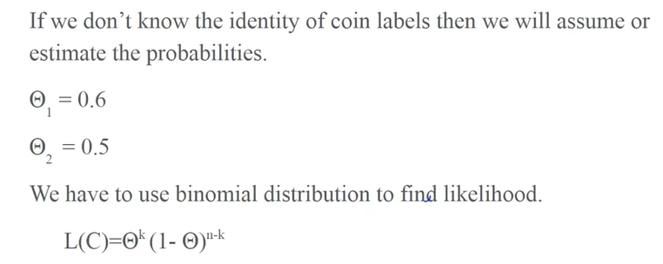

Slide 54
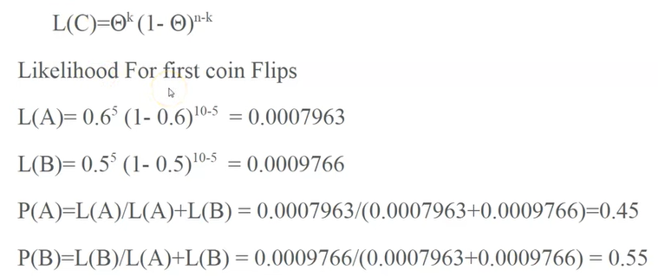

Slide 55
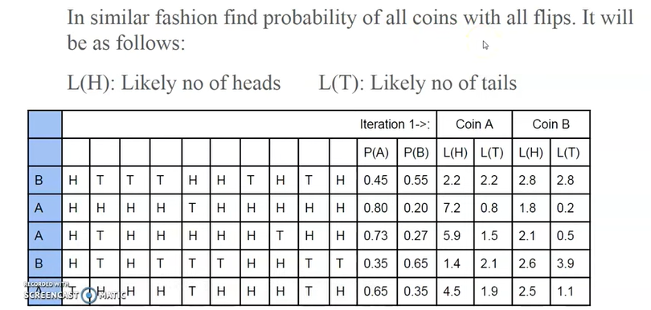
L(H) of coin A=No.of heads X P(A)

Slide 56
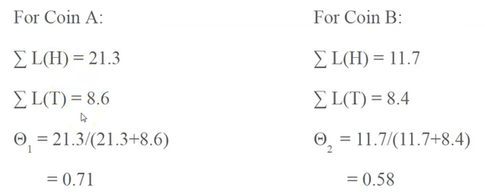

Contd..
The process will be continued until you get stable values.

Slide 57
Mixtures of Latent Variable Models
43
When full covariance matrices are used with Gaussian mixtures, even if there is no singularity, one risks overfitting if the input dimensionality is high and the sample is small.
The alternative is to do dimensionality reduction in the
clusters.
When we do factor analysis in the clusters, we look for latent or hidden variables or factors that generate the data in the clusters.
It is possible to extend this in mixture models to find
mixtures of factor analyzers.

Slide 58

CONTD..
44
In the E-step we use equation
In the M-step, we solve equation for Vi and Ψi instead
of Si .
Similarly, one can also do PCA in groups, which mixtures of is called probabilistic principal component analyzers.

Slide 59
Supervised Learning after Clustering
45
Dimensionality reduction methods find correlations between features and group features
Clustering methods find similarities between instances and group instances.
If such groups are found, these may be named (by
application experts) and their attributes be defined.
One can choose the group mean as the representative prototype of instances in the group, or the possible range of attributes can be written.
This allows a simpler description of the data.

Slide 60
Contd..
46
Allows knowledge extraction through number of clusters,
prior probabilities,
cluster parameters, i.e., center, range of features.
Example: CRM, customer segmentation.
Clustering is also used as a preprocessing stage.
After clustering, we also map to a new k
dimensionalspace where the dimensions are hi.
In a supervised setting, we can then learn the discriminant or regression function in this new space.

Slide 61
Clustering as Preprocessing
47
In the case of a method like clustering where the new dimensions are defined locally, there are many more new dimensions, bj , but only one of them have a nonzero value.
There are many dimensions but few contribute, we have
a local representation.
One advantage of preceding a supervised learner with unsupervised clustering or dimensionality reduction is that the latter does not need labeled data.
Unsupervised learning is called “learning what normally
happens”.

Slide 62
Contd..
48
In classification, the input comes from a mixture of classes (supervised).
If each class is also a mixture, e.g., of Gaussians, (unsupervised), we have a mixture of mixtures:
p(x|C ) =
k
i
( ) ( )
∑
p x|G_{ij}
P G_{ij}
i
j=1
p(x) = ∑p(x|C_{i} )P(C_{i} )
i =1
K

Slide 63
Spectral Clustering
49
Instead of clustering in the original space, a possibility is to first map the data to a new space with reduced dimensionality.
Any feature selection or extraction method can be used for this purpose, and one such method is the Laplacian eigenmaps.
Cluster using predefined pairwise similarities B_{rs}
instead of using Euclidean or Mahalanobis distance
Can be used even if instances not vectorially represented

Slide 64


Contd…
50
Steps:
◉ We define a local neighborhood (by either fixing the number of neighbors or a distance threshold), and then for instances that are in the same neighborhood, we define a similarity measure.
◉ Use k-means with the new data coordinates in this new
space.

Slide 65
Contd..
51
Consider three instances, a, b, and c. Let us say a and b lie in the
same neighborhood and so do b and c, but not a and c.
Still, because a and b will be placed nearby and b and c will be placed nearby, a will lie close to c too, and they will probably be assigned to the same cluster.
Consider now a and d that are not in the neighborhood with too
many intermediate nodes between them.
These two will not be placed nearby and it is very unlikely that they
will be assigned to the same cluster.
Depending on which graph Laplacian is used and depending on the neighborhood size or the spread of the Gaussian, different results can be obtained, so one should always try for different parameters

Slide 66
Hierarchical Clustering
52
We discussed clustering from a probabilistic point of view as fitting a mixture model to the data.
There are also methods for clustering that use only similarities of instances, without any other requirement on the data
This is the approach taken by hierarchical clustering.
This needs the use of a similarity, or equivalently a distance, measure defined between instances.

Slide 67
Hierarchical Clustering
53
Cluster based on similarities/distances
Distance measure between instances x^{r} and x^{s}
Minkowski (L_{p}) (Euclidean for p = 2)
d ( ) [ ( ) ]
r s
∑
d
r
s j
p
1/ p
x ,x =
x − x
m
j =1
j
City-block distance
d (x ,x )=
∑
d
_{x}r
r
s
x
s j
cb
j =1
j

Slide 68
Agglomerative Clustering
54
Start with N groups each with one instance and merge two closest groups at each iteration
Distance between two groups G_{i} and G_{j}:
◉ Single-link:
d(G ,G )=
i j
min d(x^{r} ,x^{s} )
x^{r} ∈G ,x^{s} ∈G
i j
◉ Complete-link:
d(G ,G )=
i j
max d(x^{r} ,x^{s} )
x^{r} ∈G ,x^{s} ∈G
i j
◉ Average-link, centroid
d(G ,G )=
ave d(x^{r} ,x^{s} )
i j
x^{r} ∈G ,x^{s} ∈G
i j

Slide 69
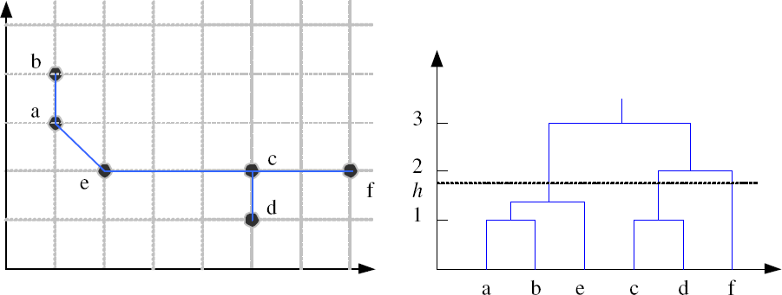
Example: Single-Link Clustering
55
Dendrogram

Slide 70
Contd..
56
Once an agglomerative method is run, the result is generally drawn as a hierarchical structure known as the dendrogram.
This is a tree where leaves correspond to instances, which are grouped in the order in which they are merged.
A divisive clustering algorithm goes in the other direction, starting with a single group and dividing large groups into smaller groups, until each group contains a single instance.

Slide 71
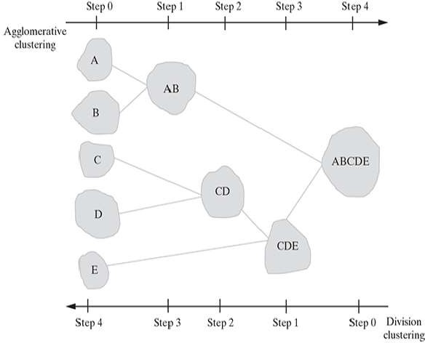
57

Slide 72
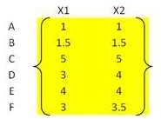
Example
58
Use single-linkage and eucledian distance to find the clusters.

Slide 73
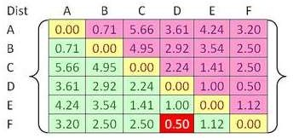
Contd..
59
Calculate the distance matrix
The closest cluster is between cluster F and D with shortest distance of 0.5.
Thus, we group cluster D and F into cluster (D, F).
Then we update the distance matrix

Slide 74
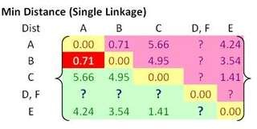
Contd..
60
Using single linkage, we specify minimum distance between original objects of the two clusters.

Slide 75
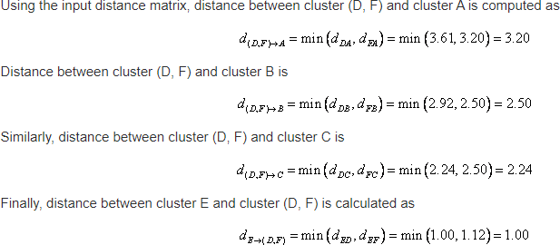
Contd..
61

Slide 76
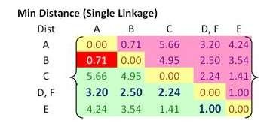
62
Then, the updated distance matrix becomes
We found out that the closest distance between cluster B and cluster A is now 0.71.
Thus, we group cluster A and cluster B into a single cluster name (A, B).

Slide 77
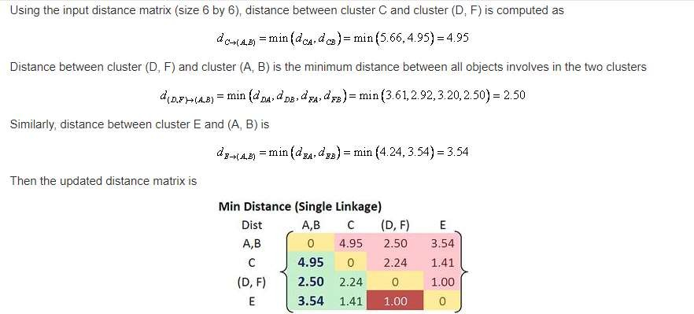
63

Slide 78
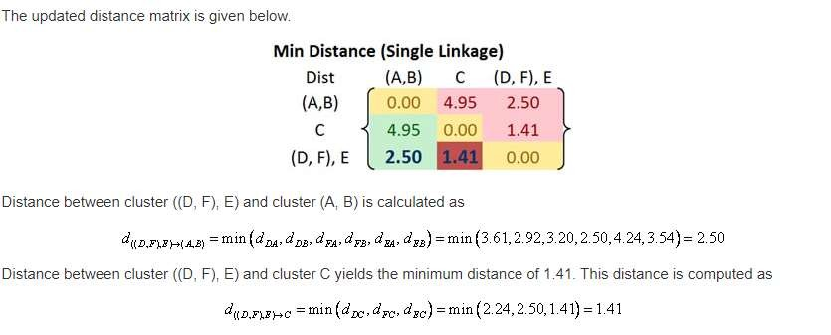
Contd..
64
The closest distance between clusters happens between cluster E and (D, F) at distance 1.00.
Thus, we cluster them together into cluster ((D, F), E ).

Slide 79
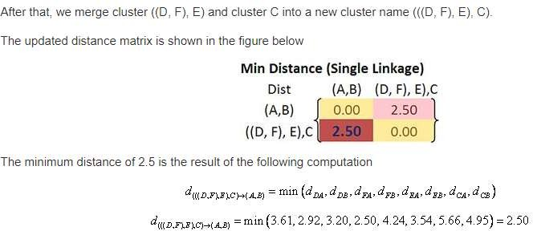
Now if we merge the remaining two clusters, we will get only single cluster contain the whole 6 objects. Thus, our computation is finished.
65

Slide 80
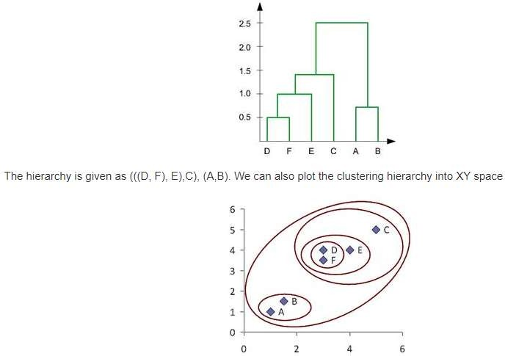
66

Slide 81
Choosing k
67
Defined by the application, e.g., image quantization
Plot data in 2-d (after PCA) and check for clusters
Incremental (leader-cluster) algorithm: Add one at a time until “elbow” (reconstruction error/log likelihood/intergroup distances)
Manually check for meaning

